Slide 1
Is Women’s Work Devalued?
Is Women’s Work Devalued?
Evidence from Unique Personnel Data of a Russian Firm during Transition (1990-2006)
WORK IN PROGRESS!
Thomas Dohmen, University of Bonn and IZA
Karolina Goraus-Tanska, University of Warsaw
Hartmut Lehmann, University of Bologna, NRU HSE and IZA
21 November 2019
Center for Institutional Studies Research Seminar
Higher School of Economics Moscow

Slide 2
Is Women’s Work Devalued?
Motivation
Devaluation of females’ work
While gender gaps in wages in most regions of the world were narrowing over time, they continue to persist in part due to how female’s work is valued.
Differences between occupations and industries in which men and women work account for more than half of the gender gap (Blau and Kahn, 2016).
“Traditionally female” occupations offer lower remunerations to its workers than male dominated occupations that require similar level of skill and education – especially pronounced when local labor market is more segmented (Cohen and Huffman, 2003).
When occupations are becoming more feminized the pay is relatively declining (Levanon et al., 2009).

Slide 3
Is Women’s Work Devalued?
Results
Changes in occupational structure and wages
Devaluation vs. queuing view
Queuing view: occupations’ wage level affect their gender composition (Reskin and Roos, 1990)
Everyone prefers to work in better paid occupations, but employers prefer men
Discrimination occurs in the process of hiring or placement
As a result, women cluster in occupations offering relatively lower wage for its skills’ requirements
Devaluation view: gender composition affects occupations’ pay (England, 1992; Sorensen, 1994; Steinberg, 2001)
Decisions of employers’ about the relative pay in more feminized occupations are affected by gender bias (Levanon et al., 2009)
Employers value less work done in more feminized occupations and consequently set lower wages.
It might be that both processes take place

Slide 4
Is Women’s Work Devalued?
Motivation
Changing situation of women over transition
Before transition, the levels of gender wage gaps were at similar level as in Western Europe countries, and female employment rates were among the highest in the world (Brainerd, 2000).
The evolution of the GWG was heterogenous between countries, e.g. increase in Russia and Ukraine (Brainerd, 2000, Newell and Reilly, 1996, Reilly, 1999, Ganguli and Terrell, 2005), and decrease in central Europe countries or East Germany (Hunt, 2002, Vodopivec and Orazem, 2000, Andren and Andren, 2015, Grajek, 2003, Pollert, 2003).
At the same time, employment rates of women were falling (Newell and Reilly, 2001, Homlong and Springler, 2006)

Slide 5
Is Women’s Work Devalued?
Motivation
Adverse effects of transition on women
Growing poverty and inequality were largely feminized (Pollert, 2003).
Revival of traditional gender roles (Pollert , 2003, Rodovic-Markovic, 2011).
Budget restrictions affecting healthcare and education benefits, as well as rights to maternity leave and childcare (Rodovic-Markovic, 2011; Pollert, 2003; Ferge Z., 1997, Ingham and Ingham, 2002).
Overall, transition countries lost their top positions in e.g. Gender-related Development Index or Relative Status of Women index (Pollert, 2003).

Slide 6
Is Women’s Work Devalued?
Motivation
Advantages of personnel data analysis I
Gender earnings differentials may be related to the productivity differences and sorting of women and men into different firms (Kremer, 1993; Carrington and Troske, 1998)
Analyzing an internal labor market allows to verify whether gender gaps remain within very homogeneous groups of workers (Kunze, 2008)
Studying career paths of workers may shed light on reasons underlying the emergence and the evolution of the gender wage gap over the course of transition

Slide 7
Is Women’s Work Devalued?
Motivation
Advantages of personnel data analysis II
This analysis might also tell us something about labor market adjustment during transition in general (e.g., how rapidly this adjustment occurs or whether there is a lot of inertia from Soviet times)
Longitudinal character of the data might allow to establish causality in the relation between occupations’ proportion of women and its wage level (devaluation vs. queuing)
The set-up of our research is a quasi-natural experiment: we observe evolution from the communist wage structure, not determined by market forces, into a wage structure that is determined by market forces.

Slide 8
Is Women’s Work Devalued?
Motivation
Previous work on gender earnings gap in the same Russian firm but with more limited data (Dohmen, Lehmann and Zaiceva 2008)
Data limitations:
Only data from 1997 to 2002
Wages are monthly wages averaged over the year
Hours worked not available – only full-time vs. part-time status
Career paths cannot be inferred from data

Slide 9
Is Women’s Work Devalued?
Motivation
Main results from previous analysis
A large fall of earnings gap from 38% in 1997 to18% in 2002.
This convergence is driven by an increase in rewards for women – in particular at the lower end of the distribution.
These differentials at the mean and across distribution are largely unexplained by observable characteristics.
For 2002, we find that differentials for production workers are mainly explained by job assignments: women are assigned to low job categories.

Slide 10
Is Women’s Work Devalued?
Motivation
This paper: Contribution I
Very rich and long panel data set, giving us:
possibility to construct real hourly wages
possibility to analyze evolution of wage gap over entire transition with monthly wage data for 17 years
very detailed information on position of workers for every month
Possibility to analyze career paths within the firm and the evolution of wages for different types of workers

Slide 11
Is Women’s Work Devalued?
Motivation
This paper: Contribution II
We evaluate the changes in relative wages of women and men going through a three step procedure:
We apply Oaxaca (1973) and Blinder (1973) decomposition to estimate the adjusted gender wage gap over the 1990-2006 period → we find that GWG increased since transition
We use second-order decomposition (Juhn et al. 1991) to verify whether increasing GWG was due to increasing within-occupation gender wage differences, or rather more feminized occupations were receiving relatively lower pay over time → we find that the latter plays a major role
We aim to disentangle factors standing behind this evolution → work in progress

Slide 12
Is Women’s Work Devalued?
Personnel data
Personnel data – information about the firm
Data covers 17 years (1990-2006)
Personnel data of a large firm operating in the sector machine building and metal works (MBMW) that produces mainly equipment for oil and gas production
Firm was established in 1950s and privatized in 1992
Firm is located in central Russia (not in Moscow, though)
Firm successfully managed transformation from military production to production of civilian goods – hence belongs to that minority of firms in the MBMW sector that managed transformation well.

Slide 13
Is Women’s Work Devalued?
Personnel data
Personnel data – information about the firm
Since 1996 firm has a steady stream of orders and a stable demand for production workers (only very briefly interrupted by the financial crisis of 1998)
Employment and wage policies determined exclusively by CEO and a few top managers (large enough block of voting shares to determine all decision making in the firm)
Wage arrears play a role in the years 1992 to 1995

Slide 14
Is Women’s Work Devalued?
Personnel data
Personnel data – information about the workers
Monthly data for the years 1990-2006
Average employment over the period: around 3700 workers
Data covers all workers apart from top managers
Many workers observed for more than a decade
Exact date of arrival in the firm and exact date of separation (if applicable) can be determined

Slide 15
Is Women’s Work Devalued?
Personnel data
Personnel data – information about the workers
Demographic information: gender, date of birth, marital status, education level, and children
Occupational categories:
managers,
accountants,
technicians (or “engineers”),
production workers
service staff
Further categorization of production workers:
primary production workers of 8 levels and
auxiliary production workers of 6 levels
Complete information on career path within the firm
Monthly wages

Slide 16
Is Women’s Work Devalued?
Personnel data
Firm was downsizing for most of the period
Year | Number of workers | Share | women
1990 | 4850 | 0.34
1992 | 4205 | 0.33
1994 | 3535 | 0.33
1996 | 3328 | 0.34
1998 | 3376 | 0.35
2000 | 3241 | 0.34
2002 | 3330 | 0.34
2004 | 3485 | 0.34
2006 | 3903 | 0.33
Mean | 3709 | 0.34

Slide 17
Is Women’s Work Devalued?
Personnel data
Insights from descriptive statistics: 1990 vs 2006
The share of older workers increased in line with demographic changes in the country - GWG higher for older workers
Educational structure is the same in 1990 and 2006 (also same share of women within each category) - GWG in 1990 higher among the lower educated, while in 2006 it is highest among those with high education
Average tenure lower in 2006 than in 1990, and gender gap in tenure emerged over time
GWG among workers without children remained the same, but strongly increased among persons with children
Shares of workers in different occupations was stable over time, and (positive) GWG emerged only for managers

Slide 18
Is Women’s Work Devalued?
Personnel data
Employment structure and wage gaps at beginning and end of transition

Slide 19
Is Women’s Work Devalued?
Results
Gender wage gap evolution
Gender wage gap over time

Slide 20
Is Women’s Work Devalued?
Results
Gender wage gap evolution
Insights from GWG evolution
GWG almost non-existent at the beginning of the analysed period
Very strong increase since 1996 and GWG peaking in the crisis year of 1998, than strong decrease to around 16% in 2006
End-of-year bonus payments had decreasing effects on GWG
Change of GWG in the firm is in line with evolutions for the Russian workforce overall, e.g. Kazakova (2007) showed the gap decreased from 35% in 1996 to16% in 2002; similar change also in Atencio and Posadas (2015)

Slide 21
Is Women’s Work Devalued?
Results
Gender wage gap evolution
GWG in Russia (Atencio, Posadas, 2015)

Slide 22
Is Women’s Work Devalued?
Results
Gender wage gap evolution
Adjusted gap - after controlling for demographic characteristics and all available covariates

Slide 23
Is Women’s Work Devalued?
Results
Gender wage gap evolution
Insights from GWG decompositions
Demographic characteristics do not explain observed GWG
Controlling for occupation types and levels makes adjusted GWG (AGWG) vanish or turn negative, except for the crisis period around 1996-1998
Decompositions across the entire distribution revealed that in 1990 AGWG was highest for those with lowest earnings, while in 2006 it is growing along the wage disitribution with highest AGWG for top earners
Stark increase in the explained component of the GWG suggests that either there was more occupational seggregation or male-dominated occupations experienced larger increases in wages

Slide 24
Is Women’s Work Devalued?
Results
Gender wage gap evolution
Decomposition of GWG evolution (Juhn et al. 1991)
GWG at time t: $W_{t}^{m}$ − $W_{t}^{f}$= $β_{t}^{m}$($X_{t}^{m}$ − $X_{t}^{f}$) + $X_{t}^{f}$($β_{t}^{m}$ − $β_{t}^{f}$)
$W_{t}^{m}$ − $W_{t}^{f}$ stands for gender differences in wages at time t
($X_{t}^{m}$ − $X_{t}^{f}$) represents differences in characteristics between men and women at time t (explained component)
($β_{t}^{m}$ − $β_{t}^{f}$) stands for differences in coefficients related to female disadvantage at time t (unexplained component).

Slide 25
Is Women’s Work Devalued?
Results
Gender wage gap evolution
Decomposition of GWG evolution (Juhn et al. 1991)
Difference in GWG between two moments in time:
($W_{2}^{m}$ − $W_{2}^{f}$) − ($W_{1}^{m}$ − $W_{1 }^{f}$) =
[$β_{2}^{m}$($X_{2}^{m}$−$X_{2}^{f}$)−$β_{1}^{m}$($X_{1}^{m}$−$X_{1}^{f}$)] + [$X_{2}^{f}$($β_{2}^{m}$−$β_{2}^{f}$)− $X_{1}^{f}$($β_{1}^{m}$−$β_{1}^{f}$)],
where the first part represents the change in explained component, ∆E, and the second part stands for the change in unexplained component, ∆U.
∆E can be transformed into:
∆E = $β_{1}^{m}$[($X_{2}^{m}$ −$X_{2}^{f}$) −($X_{1}^{m}$−$X_{1}^{f}$)] + ($X_{2}^{m}$−$X_{2}^{f}$)($β_{2}^{m}{\text{−}β}_{1}^{m}),$
where the first part represents the change in gender differences in endowments (”observed quantities”), and second part relates to changes in coefficients (”observed prices”).

Slide 26
Is Women’s Work Devalued?
Results
Gender wage gap evolution
Decomposition of differences in the raw gender wage gap between 1990 and subsequent years
→ points to devaluation rather than sorting

Slide 27
Is Women’s Work Devalued?
Results
Gender wage gap evolution
Decomposition of differences in GWG between same workers in the given year and five years later
→ points to devaluation in early period and a reversal later

Slide 28
Is Women’s Work Devalued?
Results
Changes in occupational structure and wages
Movements within the firm and in- and out- of the firm in selected sub-periods

Slide 29
Is Women’s Work Devalued?
Results
Changes in occupational structure and wages
Occupational structure of the firm and wages in January 1990

Slide 30
Is Women’s Work Devalued?
Results
Changes in occupational structure and wages
Occupational structure of the firm and wages in January 2006

Slide 31
Is Women’s Work Devalued?
Results
Changes in occupational structure and wages
Limitations and next steps
Limitations
External validity of findings is limited
High importance of hirings and separations, and limited scope for analysing career paths within the firm
Lack of information on labour market situation when not in the firm
Next steps
Analyze hirings and separations among men and women in combination with wage changes within occupations
Analyze conditions in the local labour market to understand better the outside options for men and women
Distinguishing between Devaluation vs. Queuing view to explain decreasing relative wages in more feminized occupations

Slide 32
Is Women’s Work Devalued?
Results
Changes in occupational structure and wages
Devaluation vs. queuing view
Queuing view: occupations’ wage level affect their gender composition (Reskin and Roos, 1990)
Everyone prefers to work in better paid occupations, but employers prefer men
Discrimination occurs in the process of hiring or placement
As a result, women cluster in occupations offering relatively lower wage for its skills’ requirements
Devaluation view: gender composition affects occupations’ pay (England, 1992; Sorensen, 1994; Steinberg, 2001)
Decisions of employers’ about the relative pay in more feminized occupations are affected by gender bias (Levanon et al., 2009)
Employers value less work done in more feminized occupations and consequently set lower wages.
It might be that both processes take place

Slide 33
Graphs by occupation: stock of men and women and GWG female shares and relative wages turnover of men and women and GWG

Slide 34
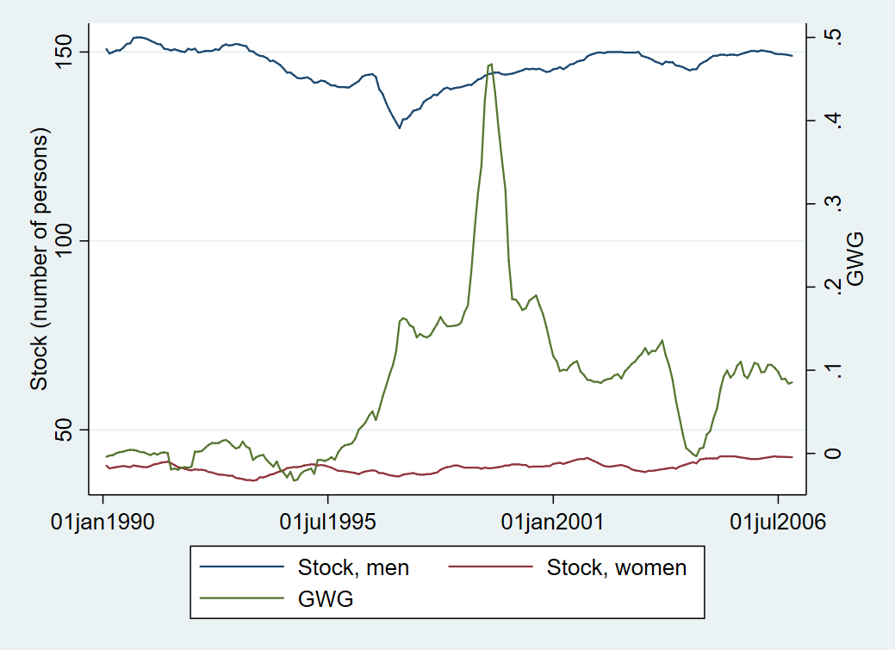
Is Women’s Work Devalued?
New graphs
Managers: stock of men and women and GWG in occupation

Slide 35
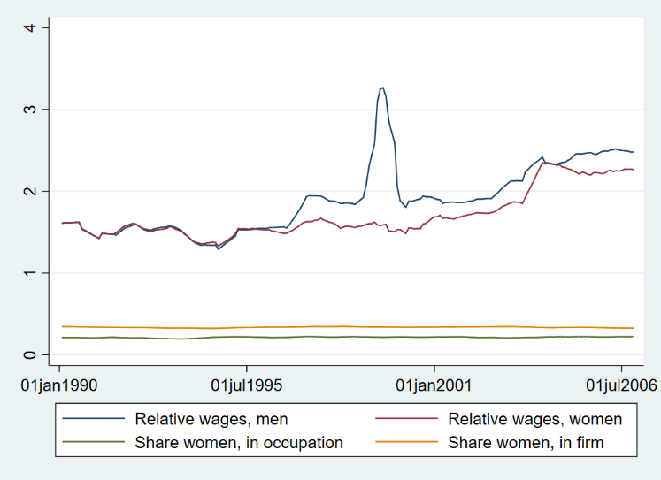
Is Women’s Work Devalued?
New graphs
Managers: female share in firm and in occupation and relative wages of women and men (as compared to average wage in firm)

Slide 36
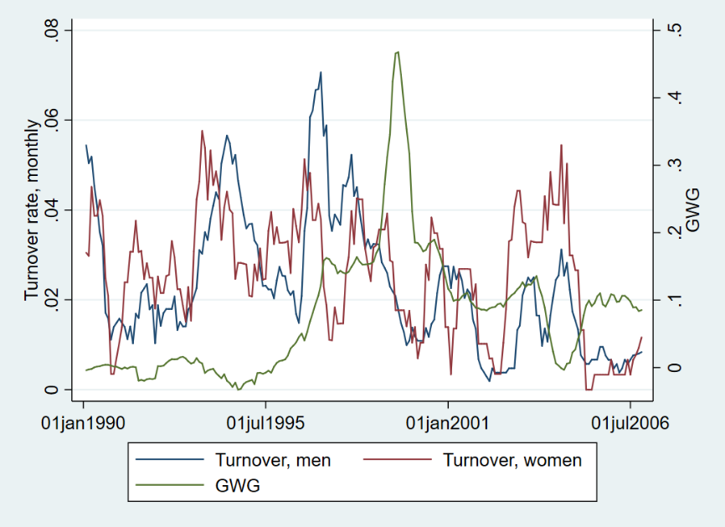
Is Women’s Work Devalued?
New graphs
Managers: turnover of men and women and GWG

Slide 37
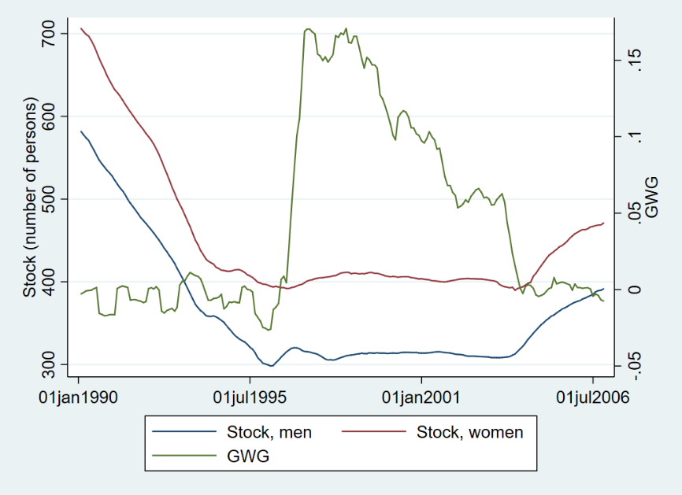
Is Women’s Work Devalued?
New graphs
Engineers: stock of men and women and GWG in occupation

Slide 38
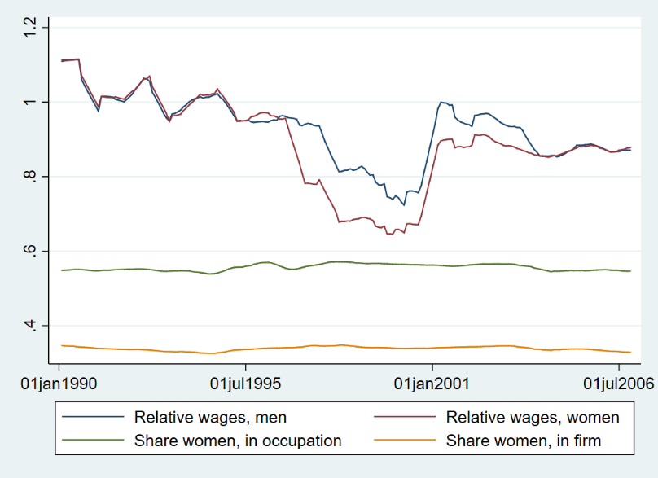
Is Women’s Work Devalued?
New graphs
Engineers: female share in firm and in occupation and relative wages of women and men (as compared to average wage in firm)

Slide 39
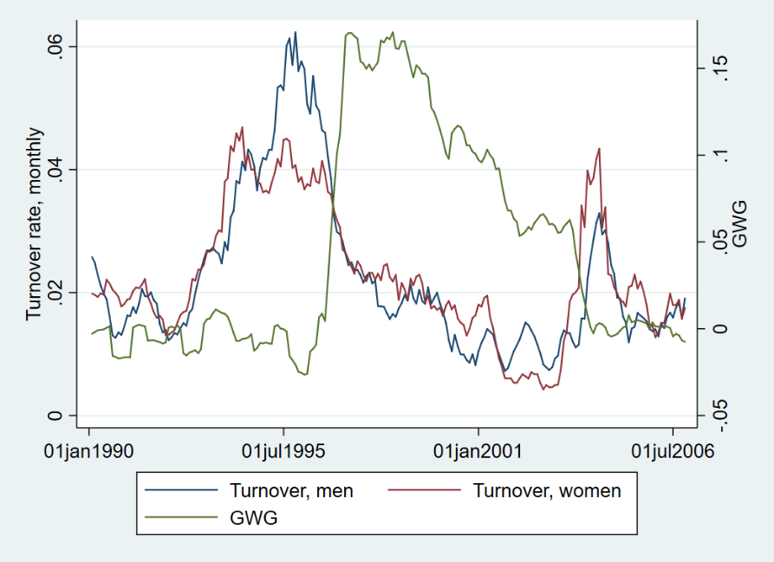
Is Women’s Work Devalued?
New graphs
Engineers: turnover of men and women and GWG

Slide 40
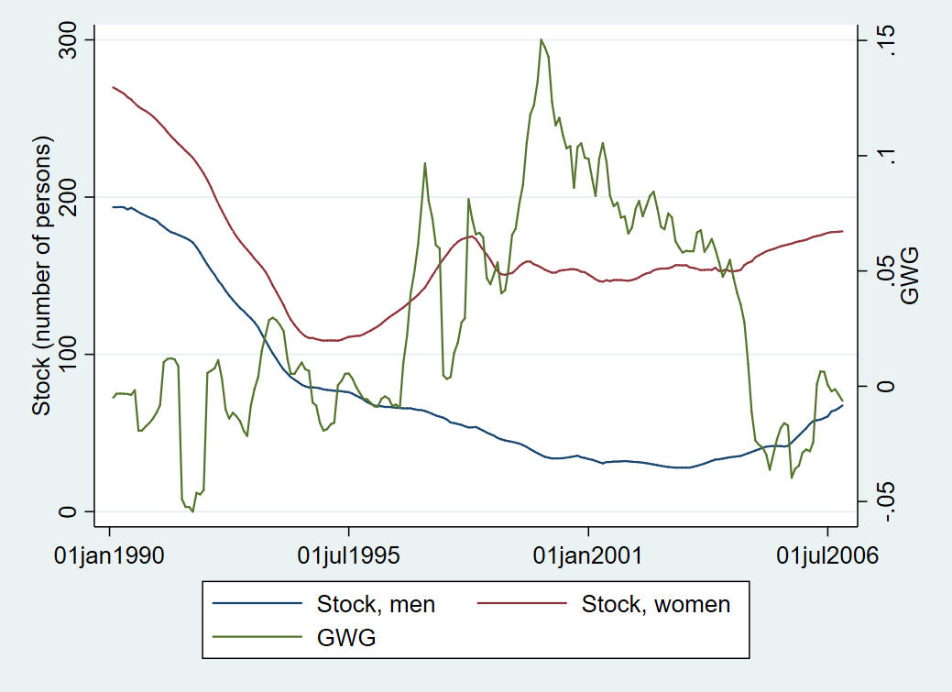
Is Women’s Work Devalued?
New graphs
Auxiliary production workers level 3: stock of men and women and GWG in occupation

Slide 41
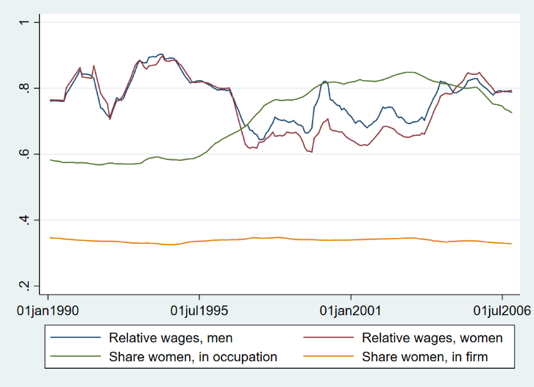
Is Women’s Work Devalued?
New graphs
Auxiliary production workers level 3: female share in firm and in occupation and relative wages of women and men (as compared to average wage in firm)

Slide 42
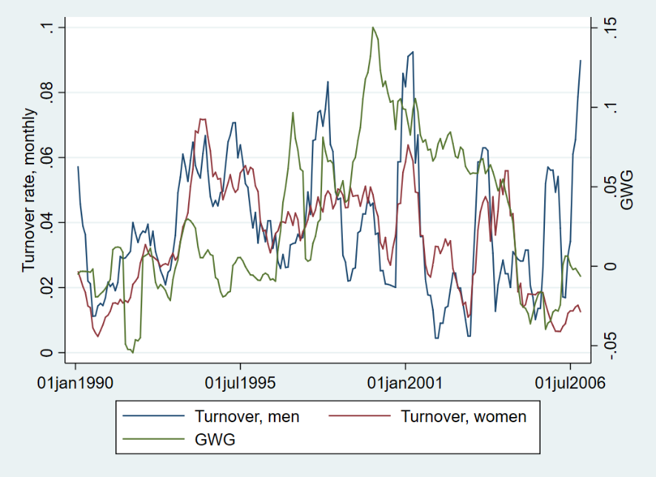
Is Women’s Work Devalued?
New graphs
Auxiliary production workers, level 3: turnover of men and women and GWG

Slide 43
Is Women’s Work Devalued?
Results
Changes in occupational structure and wages
Testing devaluation and queuing views → work in progress
The approach of Levanon at al. (2009) → Estimating structural equations model
$$W_{it}= β_{0}+ β_{1}P_{i,t−k}+ β_{2}X_{i,t−k},$$
$$P_{it}= γ_{0}+ γ_{1}W_{i,t−k}+ γ_{2}X_{i,t−k},$$
where $W_{it}$ ($W_{i,t−k}$ ) if the logged wage for occupation i in time t or ($t−k$),
$P_{it}$ ($P_{i,t−k}$ ) is logit of proportion female in an occupation i in time t or ($t−k$),
and $X_{i,t−k}$ is lagged vector of control variables.

Slide 44
Is Women’s Work Devalued?
Conclusions
Conclusions
GWG almost non-existent at the beginning of the analysed period
Very strong increase since 1996 and GWG peaking in the crisis year of 1998, than strong decrease to around 20% in 2006
Controlling for demographic characteristics, occupation types and levels makes adjusted GWG vanish or turn negative, except in the crisis period 1996-1998
The changes in the raw GWG over time are related mainly to changes in ”observed prices”, as male-dominated occupations experienced relative wage increases.
Important to look in more detail in hirings and separations and local labour market conditions
Possibility to distinguish between devaluation vs. queuing?

